Slide 1
Azure Notebooks
[ Instructor Name ]
[ Instructor E-mail ]

Slide 2

Azure Notebooks
Cloud-based service for building, editing, and sharing Jupyter notebooks
Currently free; only requires a modern browser and a Microsoft ID
Supports Python, R, and F#
https://notebooks.azure.com/
Notes:
Azure notebooks are at the core Jupyter notebooks. Azure provides from value added services for managing and sharing notebooks with others as well as a free environment for editing and running notebooks. The service is completely contained within a browser, so there’s no need to install any special software, libraries, or run times. With a modern web browser and a Microsoft ID, one can be running notebooks in no time – no strings attached.

Slide 3
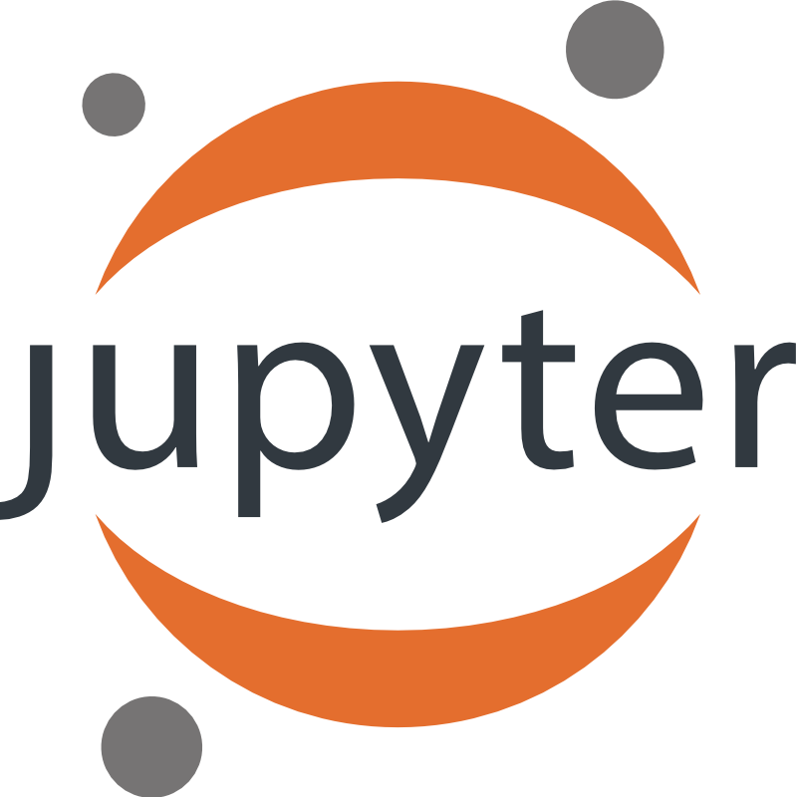
Jupyter
“The Jupyter Notebook is an open-source web application that allows you to create and share documents that contain live code, equations, visualizations and explanatory text. “
Notes:
Jupyter is a web-based applications for editing and running notebooks. It supports a number of languages including Python, R, and F#. The interactive nature of Jupyter makes it very useful for teaching and presentations in a live environment. Notebooks are intended to be shared and presented across Jupyter platforms. The nexus of these features makes Jupyter useful for data cleaning and transformation, numerical simulation, statistical modeling, machine learning, teaching, and even learning how to code.

Slide 4
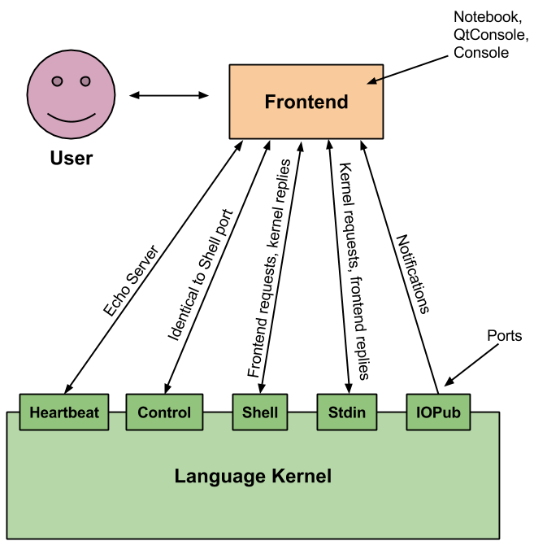
IPython
Jupyter is a web front end for IPython
IPython has a language “kernel” which provides an execution environment for whatever language is being used
State (such as variable values) is maintained between requests
Notes:
IPython is the engine behind Jupyter. It enables interactive execution of code against a state that is changed by exection states. Each supported language has its own language “kernel” that maintains the state of the execution between each states. This allows code to easily be modified and changed on the fly without losing the states. Simulations, experiments and tests to be run quickly. Kernel states can be reset if needs be to wipe out variable values.

Slide 5
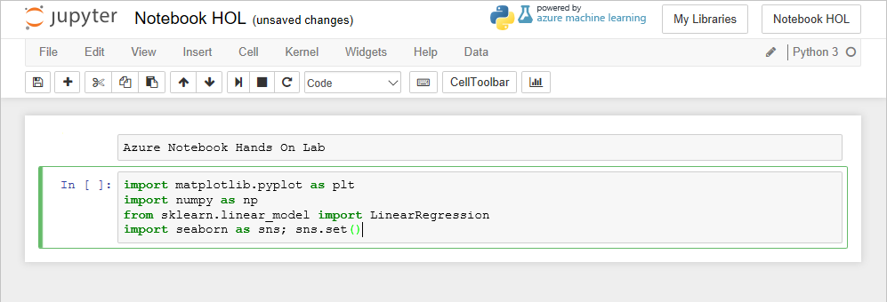
Notebooks
Notebooks are composed of cells
Markdown cells contain text (headings, notes, etc.)
Code cells contain executable code
Notes:
Notebook files contain code and markdown that annotates the code. These together allow the notebook to be edited and executed interactively, which makes them ideal for teaching, study, experimentation, and many other uses. Azure notebook currently supports three languages, each with a specific use and intended audience. The choices of libraries in those languages too enables a very powerful environment for doing all sorts of tasks.
Markdown Cells and Code Cells can be interspersed among one another. There is only a theoretical limit to the number of cells that can be contained in a notebook, so ideally code and content should be broken up into bite size pieces rather than a single cell containing everything. Commentary uses Markdown syntax while the code cells contain whatever programming language is being used in the notebook.

Slide 6
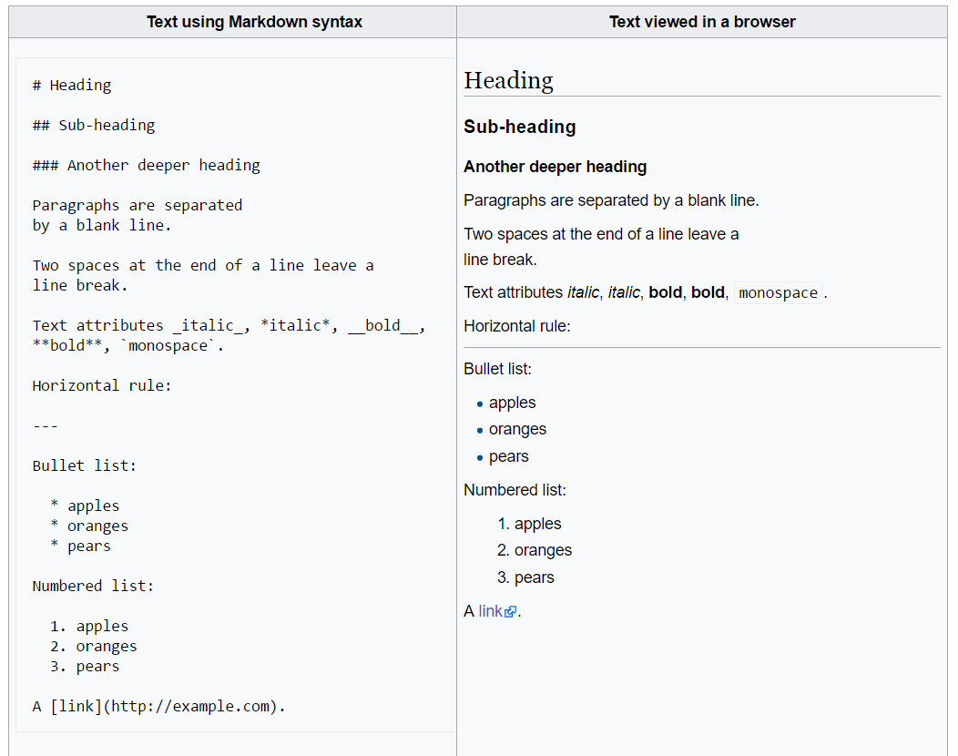
Markdown
Markdown gets its name from being the opposite of markup, which tends to be very verbose and involve lots of tags
Markdown uses symbols instead of tags to format text
Markdown is a popular format for documentation
https://github.com/adam-p/markdown-here/wiki/Markdown-Cheatsheet
Notes:
Markdown has become immensely popular for documentation in recent years due to it’s simplicity and readability. Markdown does not supply a rich set of tags and stylesheets, rather simply uses symbols to control formatting. The resulting document is not pixel perfect, but allows it to be adapted and displayed on a number of devices and media including non-GUI media like CLI’s.

Slide 7

The R Programming Language
R is a statistical programming language
R is interpreted, so it facilitates interactive programming
The R ecosystem contains numerous open-source packages for statistical manipulation and visualization
https://www.r-project.org/
Notes:
R is a interpreted language specifically aimed at statistical analysis. It contains a large number of libraries for both numerical analysis and visualization. R is also open source and wildly supported by a number of graphical front ends. This makes R very accessible to scientists and researchers for doing tests and analysis..

Slide 8
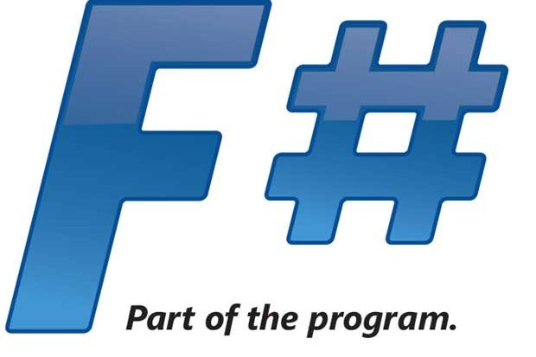
The F# Programming Language
F# is primarily a functional programming language
Functional programs focus on algorithms rather than on modifying states
This focus on algorithms allows the developer to focus on results and data structures
http://fsharp.org//
Notes:
F# is primarily a functional programming language, which unlike procedural languages that modify states of an application. F# enables algorithms to be expressed more succinctly as well as provides powerful tools for data manipulation that would be more difficult in more imperative languages. F# also has interoperability with many libraries and other tools familiar to the .NET framework in its many forms. This makes it a popular choice for developers wanting to use familiar libraries in a functional paradigm.

Slide 9

Python
Python is a multipurpose programming language that is widely used in data science
Its simplicity makes it a popular choice for entry-level programming courses and also for data scientists
https://www.python.org/
Notes:
From its inception, Python has aimed at simplicity and code readability. Code blocks are formatted using indentations rather than brackets, braces, ending statements. This makes it easy to determine the code branches in a Python program. For this reason, it has become a favorite language among those who need access to a programming language but aren’t developers or computer scientists themselves. Given its reach into academia, a number of powerful tools for doing analysis have been developed for Python.

Slide 10
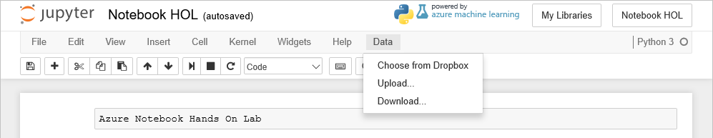
Getting Data In and Out
Data can be uploaded to Azure Notebooks through the Data menu, and then loaded into memory using function calls
Data can also be downloaded or supplied through DropBox
Notes:
Data is easily uploaded to a notebook through options in the Data menu. Azure notebooks can host the data along side the notebook and it can be imported using a library or function available in whatever programming language the notebook is using.

Slide 11
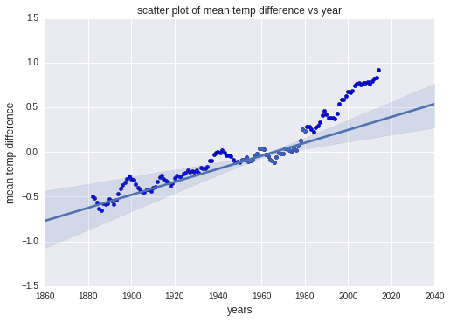
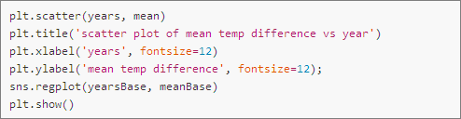
Visualizating Data
Popular packages such as Matplotlib and Seaborn make visualizations easy and are fully supported in Azure Notebooks
Notes:
A picture is worth a thousand words, so the adage goes. In Jupyter, visualizations can be generated from data and displayed inline with code cells or as part of slideshows. This is handy for plotting data in real time and updating visualizations with updates to code.

Slide 12
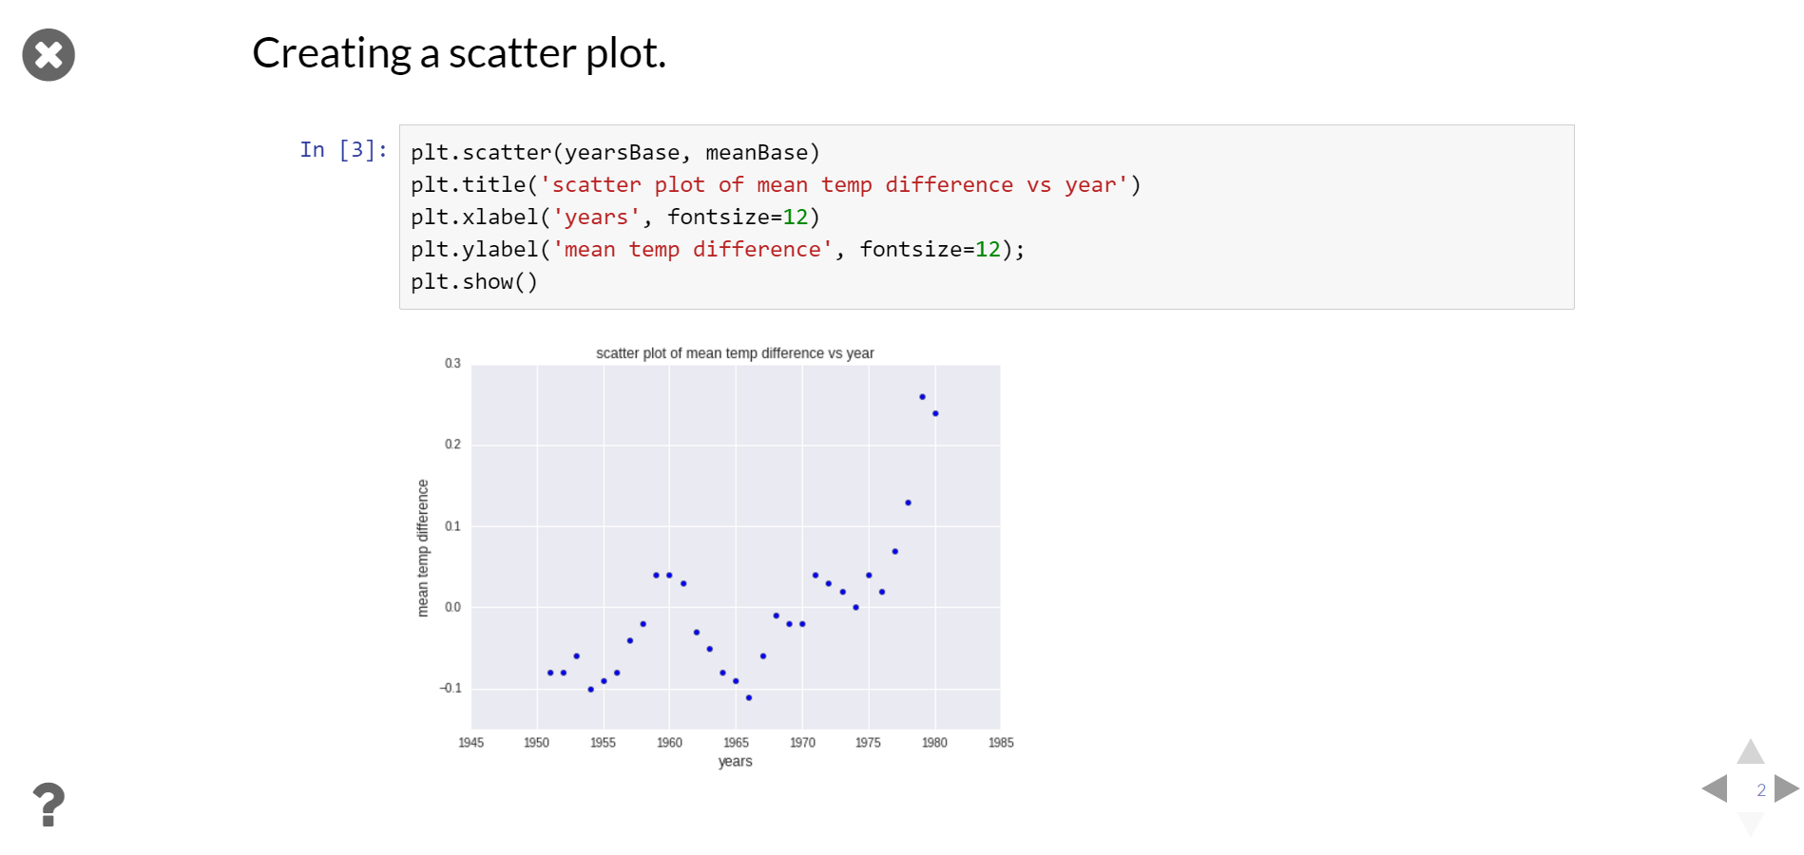
Slideshows
Slideshows are easily created from Azure Notebooks
Designate a behavior for each cell (e.g., slide or fragment) and click a button to enter slideshow mode
Notes:
The slideshow feature of notebooks enables presenters to share the notebooks and still interact with the notebook without having to install any special software. This feature is useful for doing presentations of data, results, tests, or in aiding instruction.

Slide 13
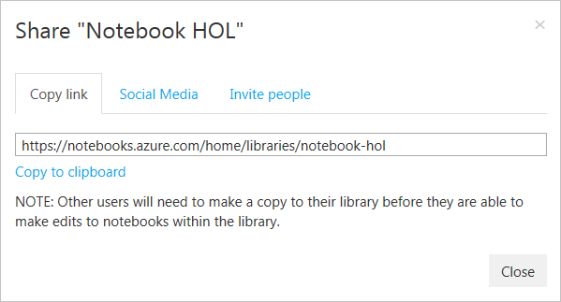
Sharing Notebooks
Notebooks can be shared via URL, social media, or e-mail
Great for collaboration or simply sharing results
Notes:
Notebooks can be kept private, but if you choose to make the library containing the notebook public, then you can share the notebook as well.

